Slide 1

Go, change the world
RV College of
Engineering
Traffic Signal Detection, Collision Avoidance and Lane Detection in Automated Vehicle
16EC73P : BE Minor Project Review
NAME: Karibasaveshwara T G USN:1RV18EC407
NAME: Nikhil G Mudakavi USN:1RV18EC414
NAME: Sainath Urankar USN:1RV18EC422
Guide Name: Dr. Abhay .A. Deshpande
Designation: Associate Professor
Department of Electronics and Communication Engineering

Slide 2

RV College of
Engineering
Go, change the world
Till Now Completed Objects:
Lane Following
Remaining Objectives
Collision Avoidance
Traffic Signal Detection

Slide 3
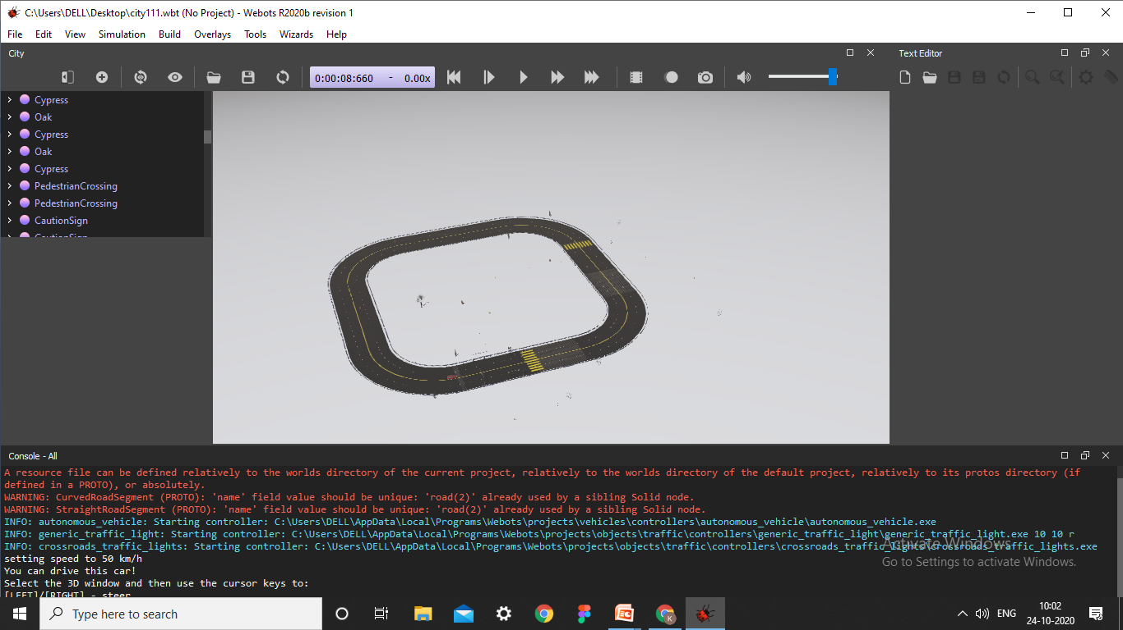
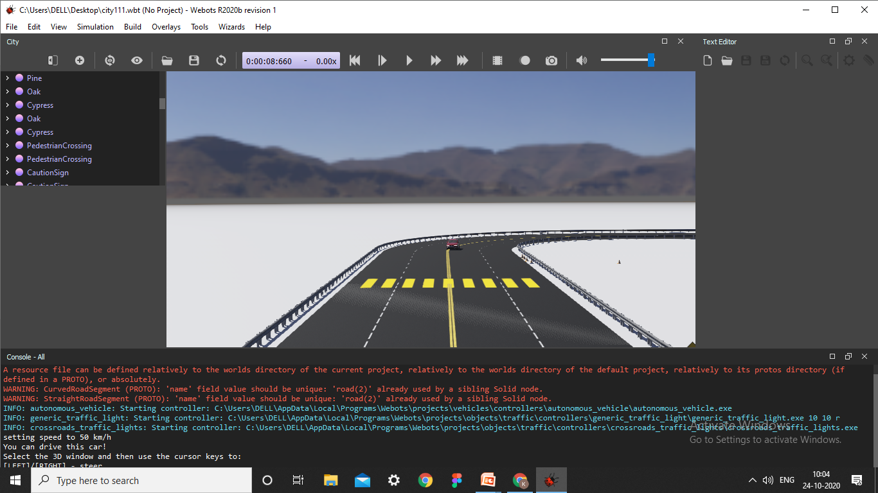
RV College of
Engineering
Go, change the world
Some of the images of our First Objective:

